Slide 1

courtesy of Joe Hellerstein for some slides
Jianlin Feng
School of Software
SUN YAT-SEN UNIVERSITY

Slide 2


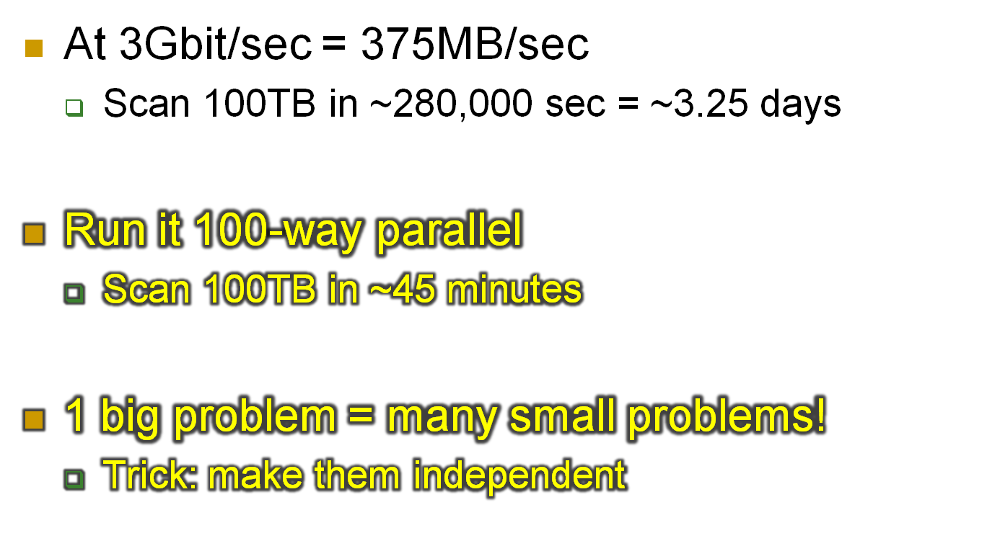

Slide 3
A little history
Relational revolution
  declarative set-oriented primitives
  1970’s
Parallel relational database systems
  on commodity hardware
  1980’s
Renaissance: MapReduce, Pig, Hive etc.
  now

Slide 4
Two Kinds of Parallelism
: any sequential program
Pipeline
Partition

Slide 5
Two Kinds of Benefit
Speed-up
  Increase HW
  Fix workload
Scale-up
  Increase HW
  Increase workload
ideal
throughput
parallelism
throughput
ideal
data size + parallelism

Slide 6
“Big Data” is GREAT for Parallelism!
Why?
  Set-oriented languages
  Batch operations
  Pre-existing divide-and-conquer algorithms
  Natural pipelining

Slide 7
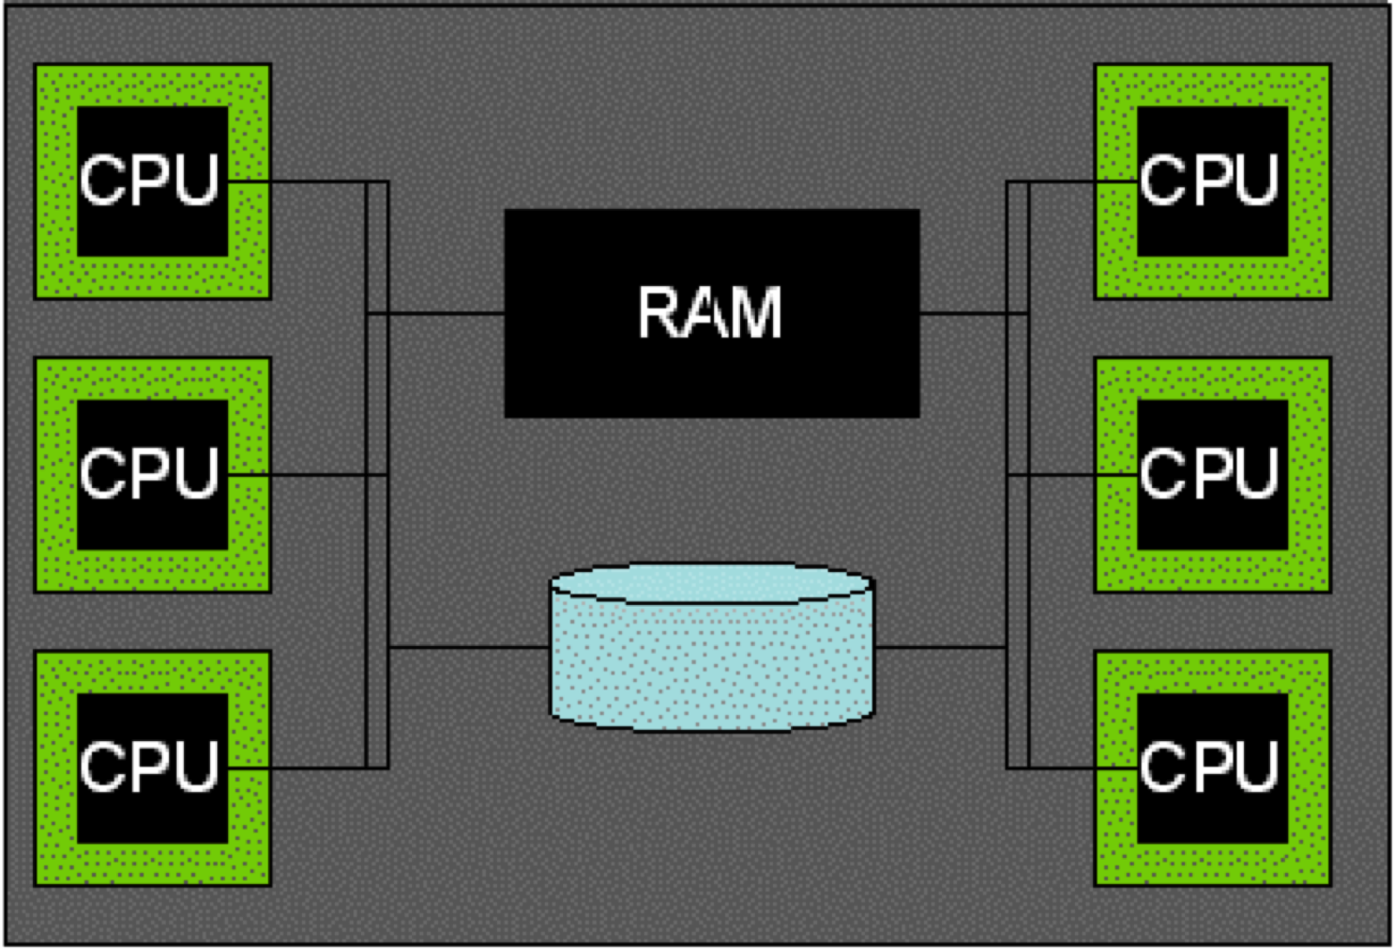
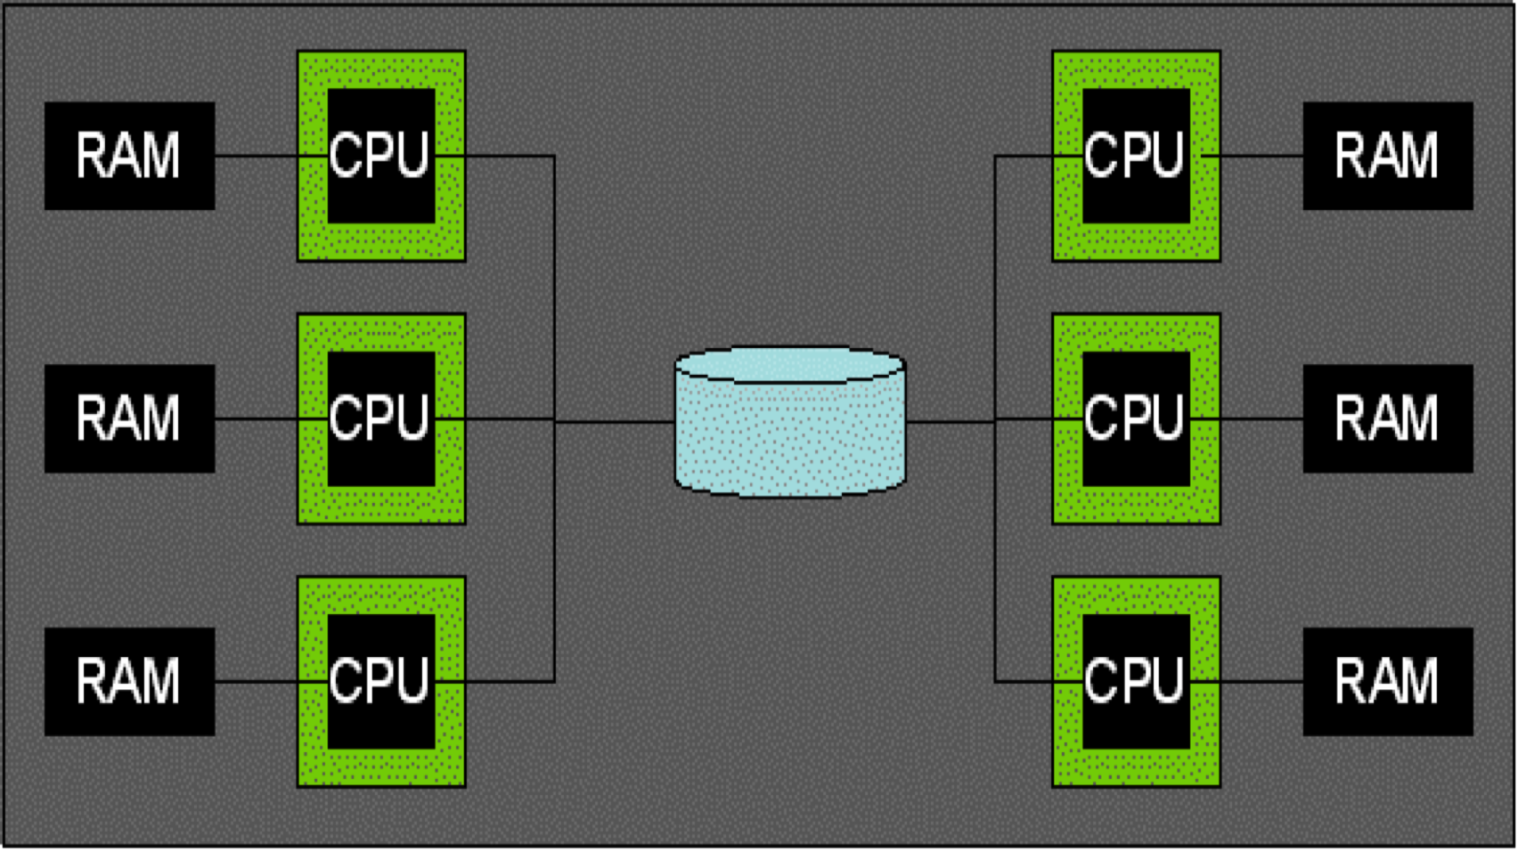
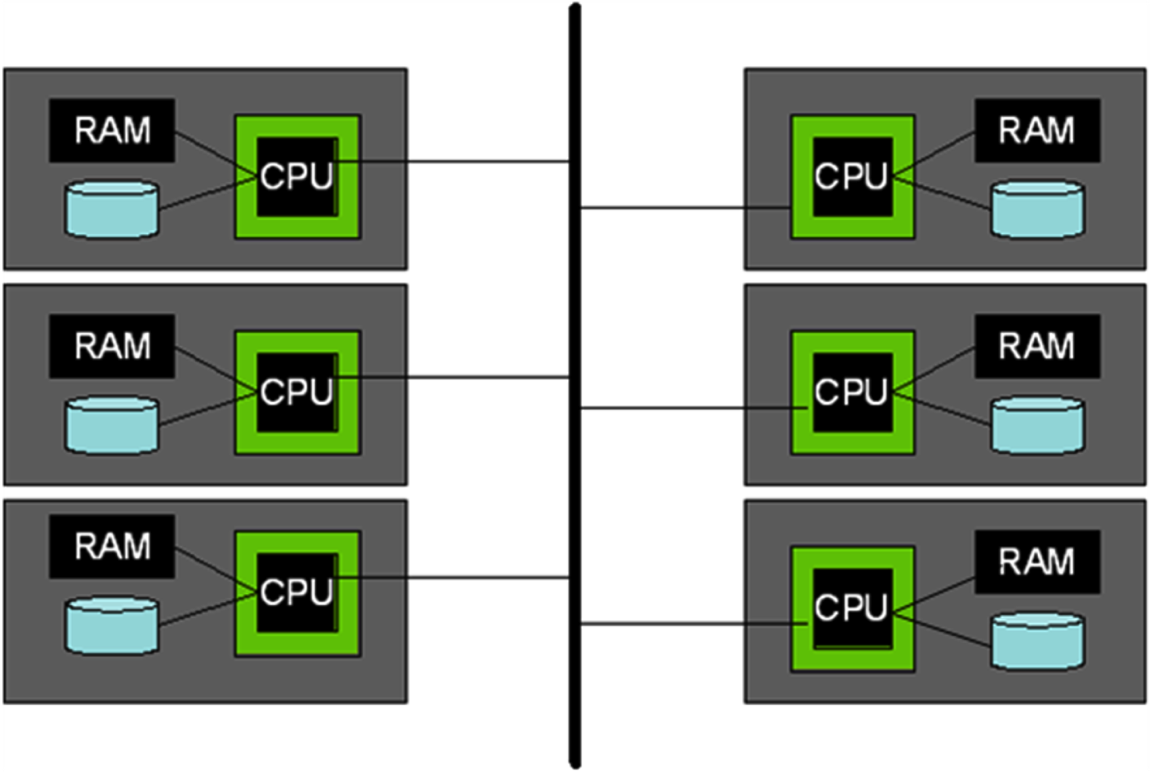
Parallel Architectures
Shared Memory
Shared Disk
Shared Nothing
(cluster)

Slide 8
Some Early Systems
Research
  XPRS (Berkeley, shared-memory)
  Gamma (Wisconsin, shared-nothing)
  Volcano (Colorado, shared-nothing)
  Bubba (MCC, shared-nothing)
Industry
  Teradata (shared-nothing)
  Tandem Non-Stop SQL (shared-nothing)

Slide 9
Uses of Parallelism
Inter-query
  Especially for Transaction Processing
Intra-query
  Inter-operator
    Tree
    Pipeline
  Intra-operator
    Divide & Conquer
    Focus here – best bang for the buck

Slide 10
Data Partitioning
Partitioning a table:
Range Hash Round Robin
A...E
F...J
K...N
O...S
T...Z
A...E
F...J
K...N
O...S
T...Z
A...E
F...J
K...N
O...S
T...Z
Good for equijoins,
range queries
group-by
Good for equijoins,
group-by
Good for spreading load
Shared nothing benefits from "good" partitioning
Notes:
77

Slide 11
Parallelism & Transactions

Slide 12
Transactions on Partitioned Data
Well, maybe this is easy
  lock data where it lives
    a “global” lock table partitioned across nodes according to the data
  log data where it lives
    and recover where it lives
What’s missing?

Slide 13
Distributed Deadlock Detection
The global waits-for graph?
  Pass around local waits-for graphs and combine
  Hard to compute accurately and efficiently
  Lazy propagation is sufficient!

Slide 14
Distributed Commit
What if one node cannot commit?
Two-Phase Commit (2PC):
  Phase 1: Run a vote
    Master broadcasts “prepare to commit!”
    Workers vote “yes” or “no”. must be unanimous!
  Phase 2: Announce results
    Master broadcasts “commit” or “abort”
    Workers ack when done
What if somebody crashes?

Slide 15
2PC + Logging
Master Log | Messages | Worker Log
 | Prepare →
 |  | prepare*/abort*
 | ← Votes (Yes/No)
commit*/abort
 | commit →
 |  | commit*/abort
 | ← ACKs
end
* is a synchronous log write – no progress til its flushed.
on failure recovery, read log and accum committing xact info in mem
discover local xact in prepared state? contact coord and ask.
discover local xact not in prepared? abort and forget
if coord and was committing, send COMMIT msgs to workers

Slide 16
Parallel Query Processing

Slide 17
Parallel Scans
Scan in parallel, merge (concat) output
Selection: may skip sites in some cases
  range or hash partitioning
Indexes can be built at each partition
Question: How do indexes differ in the different schemes?
  Think about both lookups and inserts
  What about unique indexes (keys)?

Slide 18
Lookup by key
data partitioned on function of key?
  great!
otherwise
  umm…
…
partitioned data

Slide 19
Sort, Hash
We saw these earlier in the semester
  hashing: hash to a machine, then to a partition within that machine
  sorting: split partitions into ranges, and then sort a range per machine
You do want to think about skew across nodes
  easy for hashing, a bit harder for sorting

Slide 20
Some Sorting Records
Sorting has become a blood sport!
  Parallel sorting is the name of the game ...
Minute Sort: how many 100-byte records can you sort in a minute?
  Current World record: 1353 GB. Alex Rasmussen, et al.
    52 nodes
    2 Quadcore processors, 24 GB memory, 16x500GB disks (2011)
Penny Sort: how many can you sort for a penny?
  Current world record: 334 GB
    2096 seconds on a $451 Linux/Sempron system (2011)
    $451 spread over 3 years worth of seconds
    = 2096 seconds/penny
Also JouleSort
  See http://www.sortbenchmark.org/

Slide 21
Parallel Aggregates/GroupBy
For each aggregate function, need a
local/global decomposition:
  sum(S) = Σ Σ (s)
  count = Σ count (s)
  avg(S) = (Σ Σ (s))
  / Σ count (s)
  etc...
Group by:
  Do a local aggregate for each group
    3 machines (M¹..M³), k “dno” sums each
  Ship each local agg to an appointed “collector” to compute global agg
    Hash function maps “dno” to one of 3 collector “buckets” (B₁..B₃)
    Sum up each group at exactly 1 collector
SELECT dno, SUM(sales)
FROM all_sales
GROUP BY dno
B₁
B₂
B₃
Σ₁^{1 …} Σ_{κ}¹
Σ₁^{2 …} Σ_{κ}²
Σ₁^{3 …} Σ_{κ}³
M¹
M²
M³
Advanced topic: can you think of a summary statistic this doesn’t work for?
Notes:
88

Slide 22
Parallel Joins
Nested loop:
  Compare each outer tuple with each inner tuple that might join.
  Easy for range/hash partitioning and equijoin
    Hard otherwise!
Sort-Merge (or plain Merge-Join):
  Sorting gives range-partitioning.
    But what about handling 2 skews?
  Merging partitioned tables is local.
Hash-join
  Hash-partition both inputs
  build/probe phase is local

Slide 23
Joins: Bigger picture
alternatives:
  symmetric repartitioning
    what we did so far
  asymmetric repartitioning
  fragment and replicate

Slide 24
join: symmetric repartitioning
…
equality-based join
partition
…
…
partition
…
…
input A
input B

Slide 25
join: asymmetric repartitioning
…
equality-based join
…
…
partition
input A
…
(already suitably partitioned)
input B

Slide 26
join: fragment and replicate
(a.k.a. “broadcast” join)
input A
…
…
input B

Slide 27
Complex Parallel Query Plans
Complex Queries: Inter-Operator parallelism
  Pipelining between operators:
    note that sort and phase 1 of hash-join block the pipeline!!
  Bushy Trees
Sites 1-8
Sites 1-4
Sites 5-8
A
B
R
S

Slide 28
MapReduce @ Google
And the open-source Hadoop project
Shared-disk (shared filesystem)
Goals
  Familiar single-node sequential programming over files
  Simple load-balancing and “fault tolerance” on LOTS of machines
    Why is this important as you increase the value of LOTS?
Programming Model
  Developer adds their own Java code for:
    Map (k,v) -> {(k,v)}
    Reduce ({k,v}) -> {k,v}
  You can string multiple Map/Reduce pairs into a chain
You know this, so we won’t say much.

Slide 29
Hadoop and PostgreSQL Extensibility
Hadoop Map and PG UDF are pretty similar
  Though Hadoop Map can return multiple outputs per input
Hadoop Reduce and PG UDA (User-defined Agg):
  Hadoop Reducer given an iterator for the group
    Programmer loops and produces output
    Requires Hadoop to use Sort-based group-by!
  PostgreSQL aggregate uses transVals
    Programmer has to think about state transitions
    Allows for any group-by algorithm
  Hadoop Reducers can give multiple outputs
    SQL aggs produce just one
    Though there are workarounds
Some SQL engines now offer a MapReduce syntax
  Greenplum & Aster (both based on Postgres).
  Teradata & Netezza. (Netezza based on Postgres).

Slide 30
Google MapReduce
Master
Reducers
fetch their
Hash
partitions
Input “Splits”
(GFS)
Map Workers
Local Files
(at mappers)
Reduce
Workers
Output Files
(GFS)

Slide 31
Architectural Differences
Main difference from RDBMS: no pipelining
  Push-to-disk rather than iterators
    Maps read from GFS, write to local disk
    Reduces fetch from mappers, write to GFS
  Why all the disk writing?
    Fault-tolerance
    “Straggler” handling via competition
  “Master” node orchestrates every step of the work
    Assigns work
    Monitors performance and assigns competitors to stragglers

Slide 32
Faults and Stragglers
Workers send “heartbeat” status reports to master
If a worker doesn’t heartbeat?
  Master starts a new one
  Informs consumers of the new worker’s output
Near the end of the job, the “stragglers” can drag you down
  Trick: if a worker is making slow progress, start up a clone
  If clone wins, inform its consumers!
All made easy by lack of pipelining!
  Is this a good or bad idea?

Slide 33
Parallel DBMS Summary
Parallelism natural to query processing:
  Both pipeline and partition
Shared-Nothing vs. Shared-Mem vs. Shared Disk
  Shared-mem easiest SW, costliest HW.
    Doesn’t scale.
  Shared-nothing cheap, scales well, harder to implement.
  Shared disk a middle ground
    Introduces icky stuff related to concurrency control
Intra-op, Inter-op, & Inter-query parallelism all possible.

Slide 34
Parallel DBMS Summary, cont.
Data layout choices important!
Most DB operations can be done partition-parallel
  Sort.
  Sort-merge join, hash-join.
Complex plans.
  Allow for pipeline-parallelism, but sorts, hashes block the pipeline.
  Partition parallelism achieved via bushy trees.

Slide 35
Parallel DBMS Summary, cont.
Transactions actually pretty easy
  distributed deadlock detection
  two-phase commit
2PC not great for availability, latency
  single failure stalls the whole system
  transaction commit waits for the slowest worker

